Slide 1
TED talks analyzes the relationship between labels and view traffic
Name：張文有,芮嘉輝,黃泀翰,黃彥穎
Sid：105590009, 105590023, 105590024, 105590026
Date：06/17/2020
National Taipei University of Technology
Computer Science and Information Engineering

Slide 2

Outline
•Introduction
•Literature review and related works
•Problem statement
•Proposed models (approaches)
•Experiments
•Conclusions
•Others

Slide 3
Introduction
Motivation
The official TED.com website uploaded all audio-video recordings of TED Talks.
We would like to use these datasets to analyze which videos are popular.
Analyzing what kind of tags and features are attractive. Using machine learning to recommend the hottest video.
Object
Analysis a large amount of free data provided by TED. Tell users effective information through data analysis. Provide users with a better experience and choice when watching TED.
Notes:
動機 1.TED Talk的官網上有許多免費的演講可以觀看
2.我們想要將這些資料分析那些演講是熱門的
3.我們想要分析哪些Tag、feature是吸引人的， 並且用機器學習來推薦最熱門的影片 目標 我們會分析這些大量免費的資料，告訴使用者、創作者有效的資訊，提供給使用者、創作者更好的使用體驗跟選擇。

Slide 4
Literature review and related works
Predicting TED Talks Views with ML Models
Recommender Systems:Content-based Systems & Collaborative Filtering
Notes:
1. 這篇教我們使用機器學習，透過XGBRegressor、ExtraTreesRegressor、LGBMRegressor 、 Random forest 來預測觀看次數。 但是這篇的預測結果誤差太大，所以我們並沒有使用相同的做法，我們有使用別的方法去做。

Slide 5
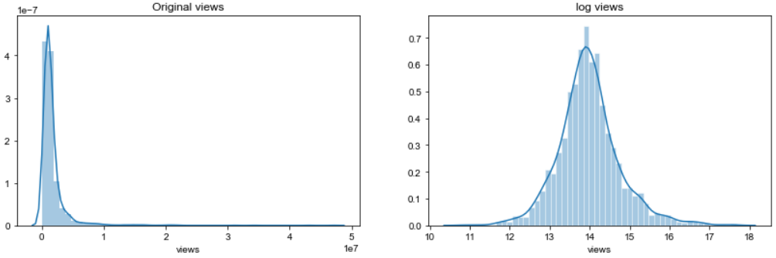
Problem statement
Data standardization : If the views are directly grouped as target, the data will be too concentrated, resulting in prediction bias, and the logarithm function is used to smooth the views data.

Slide 6
Proposed models (approaches)
SVC (Support Vector Machine)：The purpose of using SVC is to classify, and it is expected to predict the interval of the number of views and give the selected features(tag, relate views, language, etc.). Set the ratio of training data and test data to 3:7. We also try different features and finally get the best prediction result.
Data[x1, x2,…]
Predict
Class 1
Class 2
Class 3
Class 4
Class 5
Test Data
Check
Accuracy score
Notes:
我們使用SVC的目的是為了做分類，期望透過SVC去給定我們選擇的features，並且預測觀看次數。 將我們的資料分成3 : 7 3等分的訓練資料 7等分的測試資料。 我們也會去嘗試不同的feature來達到更棒的期望值。

Slide 7
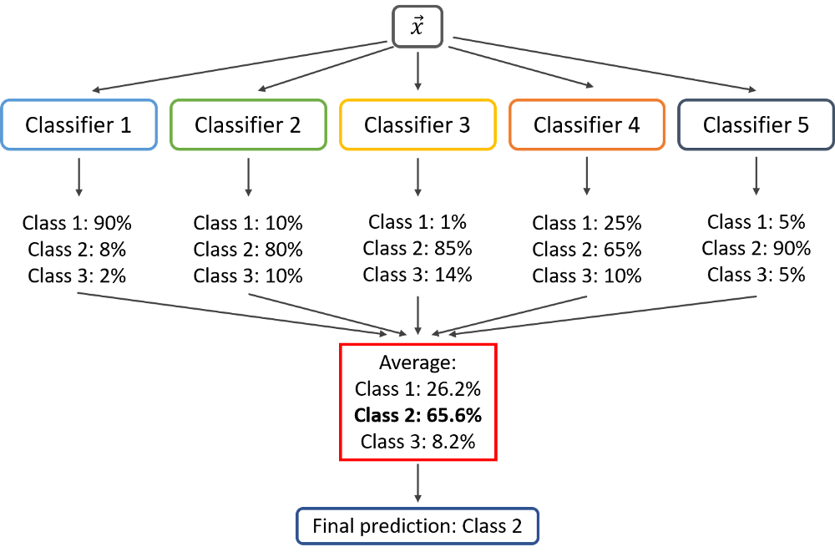
Proposed models (approaches)
Better Prediction: Voting Classifier A Voting classifier model combines multiple different models (i.e., sub-estimators) into a single model, which is (ideally) stronger than any of the individual models alone.
Notes:
我們會以多個預測出來的模型下去做投票，投出更佳的模型下去做預測。

Slide 8
Experiments
Data processing ：Various datasets frequently have missing values, so first we check the TED Talks datasets have any wrong. We will fill in those missing values with a default “Other” value.
One-Hot-Encoding ：We apply One-Hot-Encoding on the categorical attributes and get the data ready for training machine learning models. Then We print out the dimensions of the final dataset.
Label encoding
One-Hot-Encoding
Color
Red
Red
Yellow
Green
Yellow
Red | Yellow | Green
1 | 0 | 0
1 | 0 | 0
0 | 1 | 0
0 | 0 | 1
0 | 1 | 0
Notes:
Label encoding : 把每個類別 mapping 到某個整數，不會增加新欄位
One hot encoding : 為每個類別新增一個欄位，用 0/1 表示是否
這兩個編碼方式的目的是為了將類別 (categorical)或是文字(text)的資料轉換成數字，而讓程式能夠更好的去理解及運算，方便我們進行機器學習。

Slide 9
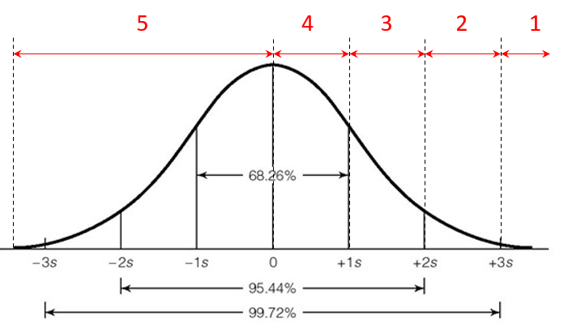
Experiments
Target：We take the logarithm of views, then according to the mean of views and standard deviation, divided views into five groups. Use 1~5 to represent each viewing frequency interval, so that machine learning can predict its result.
Notes:
我們取log的目的在於讓他跟接近常態分佈。 使用1 – 5 代表觀看次數的區間，依照下方這張圖，讓ML來預測結果。

Slide 10
Methodology
Data Collection
Data Preparation
Training
Evaluations
Tuning

Slide 11
Conclusions
We have successfully analyzed and predicted views of each speech, and the prediction rate reaches 60%.
The purpose of our project is to provide a reference for users and creators. Everyone can make a screening based on our predicted results before watching the speech, so that users can choose the speech that is most suitable for them.
Notes:
1. 我們成功分析、預測出TED Talks 每部演講的觀看次數，預測出來的次數有達到6成的準確率。
2. 我們專案的目的是在於提供給使用者、創作者做一個參考，讓大家在觀看演講之前，可以透過我們預測出來的結果，做一個篩選的動作，讓使用者選擇到最符合自己的演講。

Slide 12
Others
Collect data
Collect data
Data visualization
Prepare Final Report
Data visualization
Prepare Final Report
05/11
05/24
05/25
06/05
06/15
Data processing
Data processing
Model training
Model training
Name | workload | ratio
黃泀翰 | Visualization , make PPT | 25%
張文有 | Data processing | 25%
黃彥穎 | Voting classifier | 25%
芮嘉輝 | Machine learning | 25%

Slide 13
Demo

